Slide 1
College Technical Math 1
Section 4.2
Metric System of Measure

Slide 2
Metric System of Measure
The metric system (International System of Units or SI) is a measurement system based on powers of 10.
Every category of measure has a “base unit” which with the addition of the base 10 prefixes represent larger or smaller units of measure.

Slide 3
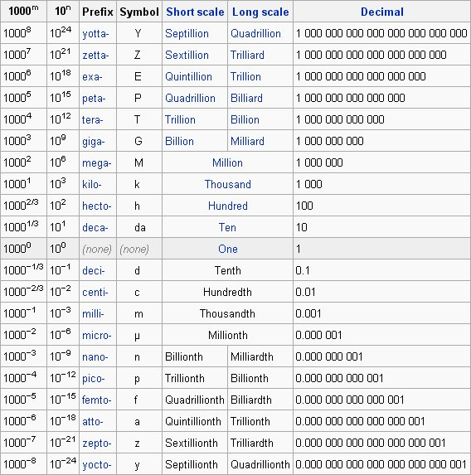
Metric Prefixes

Slide 4
Metric System Measure - Length
Base unit – meter (m)
A meter is slightly larger than a yd
Measure lengths and distances (room dimensions, land dimensions, heights of buildings, etc.)

Slide 5
Metric System Measure - Length
kilometer (km) = 1000 m
A kilometer is about .6 miles
Measure long distances(from city to city, driving speeds, etc.)

Slide 6
Metric System Measure - Length
centimeter (cm) = $\frac{1}{100}m$
A centimeter is about .4 inches (width of a paper clip)
Measure medium sized objects(tires, clothing, textbooks, etc..)

Slide 7
Metric System Measure - Length
millimeter (mm) = $\frac{1}{1000}m$
A millimeter is about the thickness of a dime
Measure small sized objects(bolts, moles, etc..)

Slide 8
Metric System Measure - Length
Choose the most reasonable metric measure. (Skill Check)
Height of a 6-year old pediatric patient:
(a) 1.5 km
(b) 1.5 m
(c) 1.5 cm
(d) 1.5 mm

Slide 9
Metric System Measure - Length
Choose the most reasonable metric measure. (Skill Check)
Distance from Los Angeles to San Francisco:
(a) 800 m
(b) 800 mm
(c) 800 km
(d) 800 cm

Slide 10
Metric System Measure - Length
Choose the most reasonable metric measure. (Skill Check)
Overall accumulation of snowfall:
(a) 8 cm
(b) 8 m
(c) 8 km
(d) 8 dkm

Slide 11
Metric System Measure – Weight/Mass
Base unit – gram (g)
Mass of 1 cubic cm of water
Weigh light objects(paper clips, sugar cubes,coins, etc.)

Slide 12
Metric System Measure – Weight/Mass
kilogram (kg) = 1000 g
A kilogram is about 2.2 pounds
Weigh regular objects (people, books, automobiles, etc.)

Slide 13
Metric System Measure – Weight/Mass
milligram (mg) = $\frac{1}{1000}g$
Weigh small objects(vitamins, prescription drugs, etc..)

Slide 14
Metric System Measure – Weight/Mass
Choose the most reasonable metric measure. (Skill Check)
Weight of a teaspoon of sugar:
(a) 2 g
(b) 2 mg
(c) 2 kg
(d) 2 hg

Slide 15
Metric System Measure – Weight/Mass
Choose the most reasonable metric measure. (Skill Check)
Weight of a Vitamin C tablet:
(a) 184 kg
(b) 184 g
(c) 184 cg
(d) 184 mg

Slide 16
Metric System Measure – Weight/Mass
Choose the most reasonable metric measure. (Skill Check)
Weight of a bag of dog food:
(a) 25 g
(b) 25 kg
(c) 25 mg
(d) 25 dg

Slide 17
Metric System Measure – Capacity
Base unit – Liter (L)
Liter is approximately equal to a quart
Determine the volume of regular objects(soda, gas, etc.)

Slide 18
Metric System Measure – Capacity
Milliliter (mL) = $\frac{1}{1000}L$
Same volume as a cubic centimeter $cm^{3}$
Determine the volume of smaller objects (medicines, perfumes, etc.)

Slide 19
Metric System Measure – Capacity
Choose the most reasonable metric measure. (Skill Check)
Volume of a tank of pesticide:
(a) 60 L
(b) 60 mL

Slide 20
Metric System Measure – Capacity
Choose the most reasonable metric measure. (Skill Check)
Volume of a glass of orange juice:
(a) 0.12 mL
(b) 0.12 L

Slide 21
Metric System Measure – Capacity
Choose the most reasonable metric measure. (Skill Check)
Dose of cough medicine:
(a) 100 L
(b) 100 mL

Slide 22
Metric Measure Conversions
Since the metric system of measure is based on powers of 10, conversions between units of measure in the metric system involve either multiplying (moving the decimal point right) or dividing (moving the decimal point left) by powers of 10.

Slide 23
Metric Measure Conversions
kilo | hecto | deka |  | deci | centi | milli | . | . | micro
k | h | dk | Base | d | c | m | . | . | $$μ$$
“Knights Hate Dragons Because Dragons Can Melt ..Metal!”

Slide 24
Metric Measure Conversions
Move the decimal point right
kilo | hecto | deka |  | deci | centi | milli | . | . | micro
k | h | dk | Base | d | c | m | . | . | $$μ$$
Move the decimal point left

Slide 25
Metric Measure Conversions
Convert 3.45 km to m. (Example)
kilo | hecto | deka |  | deci | centi | milli | . | . | micro
k | h | dk | Base | d | c | m | . | . | $$μ$$
Move the decimal point 3 places to the right
$$3.45 km=3,450 m$$

Slide 26
Metric Measure Conversions
Convert 12,300 mg to kg. (Example)
kilo | hecto | deka |  | deci | centi | milli | . | . | micro
k | h | dk | Base | d | c | m | . | . | $$μ$$
Move the decimal point 6 places to the left
$$12,300 mg=0.0123 kg$$

Slide 27
Metric Measure Conversions
Complete each metric conversion. (Skill Check)
$$8 hL to dkL 80 dkL$$
$$4 L to cL 400 cL$$

Slide 28
Metric Measure Conversions
Complete each metric conversion. (Skill Check)
$$8200 mg to g 8.2 g$$
$$17 cm to m 0.17 m$$

Slide 29
Metric Measure Conversions
Complete each metric conversion. (Skill Check)
$$How many g are in 47 dg? 4.7 g$$
$$How many decimeters are in 4,389 cm?$$
$438.9 dm$

Slide 30
Operations on Metric Measures
Since the metric system is based on the base 10 decimal system, as long as the unit of measure is the same for two quantities, the operations on metric units (adding, subtracting, multiplying, and dividing) are completed the same as with any real number.

Slide 31
Operations on Metric Measures
Add: $5 cL+9 mL$ (Example)
$$5 cL+9 mL=50mL+9 mL=59 mL$$
Subtract: $14 kg−39 hg$ (Example)
$$14 kg −39 hg=14 kg−3.9 kg=10.1 kg$$

Slide 32
Operations on Metric Measures
Multiply: $(50.32 dm)(3)$ (Example)
$$(50.32 dm)(3)=150.96 dm$$
Divide: $(54 dL)÷6$ (Example)
$$\left(54 dL\right)÷6=9dL$$

Slide 33
Operations on Metric Measures
A patient absorbs 175 mL of fluid through an IV. If the bag has 825 mL left, how much fluid was in the bag to begin with? (Skill Check)
$$1000 mL$$

Slide 34
Operations on Metric Measures
653 dkL of orange juice concentrate is removed from a vat containing 8 kL of the concentrate. How much concentrate remains in the vat? (Skill Check)
$$1.47 kL=147 dkL$$

Slide 35
Operations on Metric Measures
An IV bag holding 250 mL of an antibiotic is calibrated (marked off) into five equal sections. How many milliliters are represented by each section? (Skill Check)
$$50 mL$$

Slide 36
Operations on Metric Measures
Multiply: 0.25 cL of cologne by 5.(Skill Check)
$$1.25 cL$$

